Slide 1
Music Genre Classification(GTZAN dataset)
By :
Yash Raj Kesarwani & Vasukumar Kotadiya

Slide 2
Introduction
Why are we doing this? Music. Experts have been trying for a long time to understand sound and what differentiates one song from another. How to visualize sound. What makes a tone different from another.

Slide 3
Methods used
K-nearest Neighbour (KNN)
Artificial Neural Networks(ANN)
Convolution Neural Networks(CNN)

Slide 4
K-nearest Neighbour
A K-nearest neighbour is a data classification algorithm that attempts to determine what group a data point is in by looking at the data points around it.

Slide 5
Artificial Neural Network
An artificial neuron network (neural network) is a computational model that mimics the way nerve cells work in the human brain.

Slide 6
Convolution Neural Network
A convolutional neural network (CNN) is a specific type of artificial neural network that uses perceptrons, a machine learning unit algorithm, for supervised learning, to analyse data.

Slide 7
KNN(Machine Learning) vs. CNN(Deep learning)
In KNN, output completely relies on nearest Neighbors, which may or may not be good choice. Also it is sensitive to distance metrics.
On the other hand, CNN extract the features from the input data. Which are very helpful for making analysis. And recent success in the CNN specially wavelet for the audio application, i will prefer to go with CNN.

Slide 8
ANN vs. CNN
ANN is ideal for solving problems regarding data. Forward-facing algorithms can easily be used to process image data, text data, and tabular data. CNN requires many more data inputs to achieve its novel high accuracy rate.

Slide 9
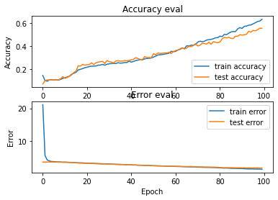
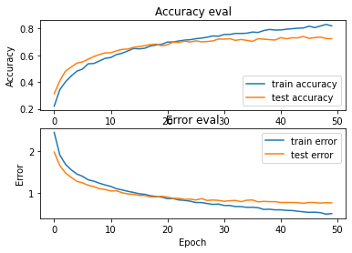
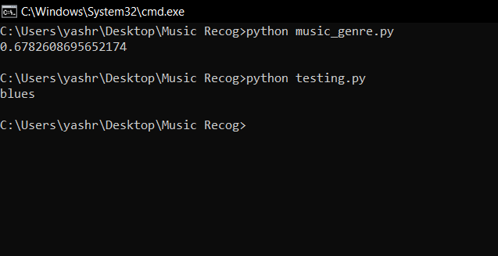
Test Comparisons
ANN
CNN
KNN

Slide 10
Result
Firstly we had solved the problem statement to classify music according to their genre by KNN in which we had achieved the accuracy of 67.8%. When we used CNN which is much more advanced data classification model we had achieved a slight increase in accuracy hence reaching the accuracy of 73%.

